Slide 1
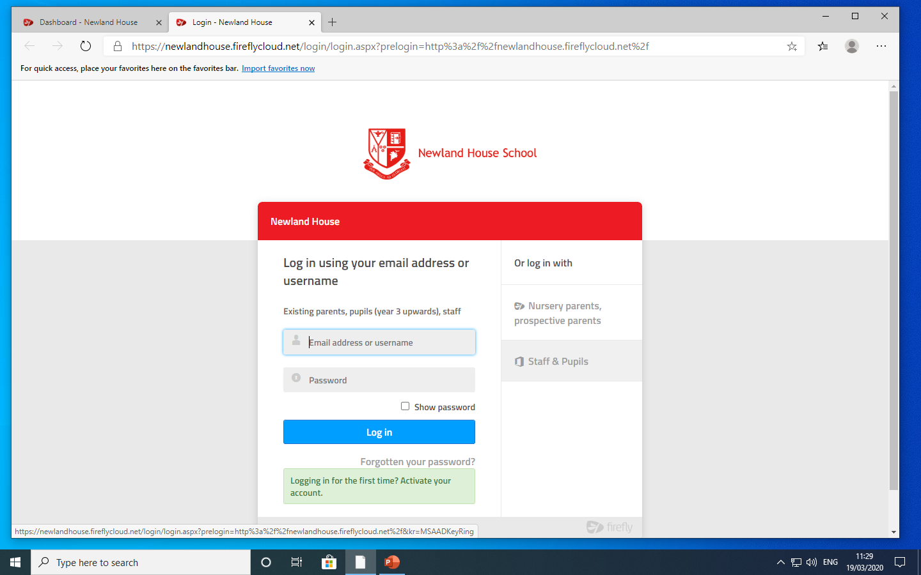
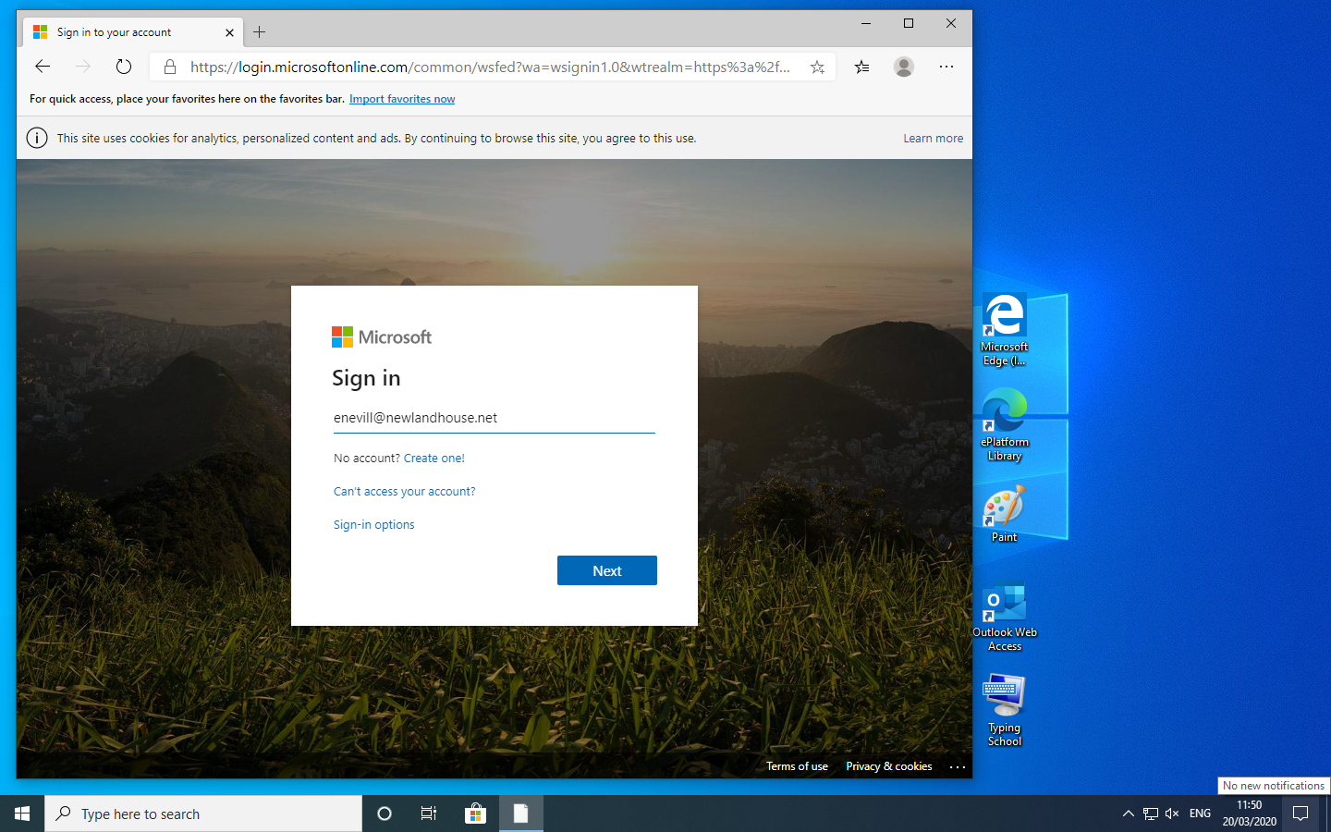
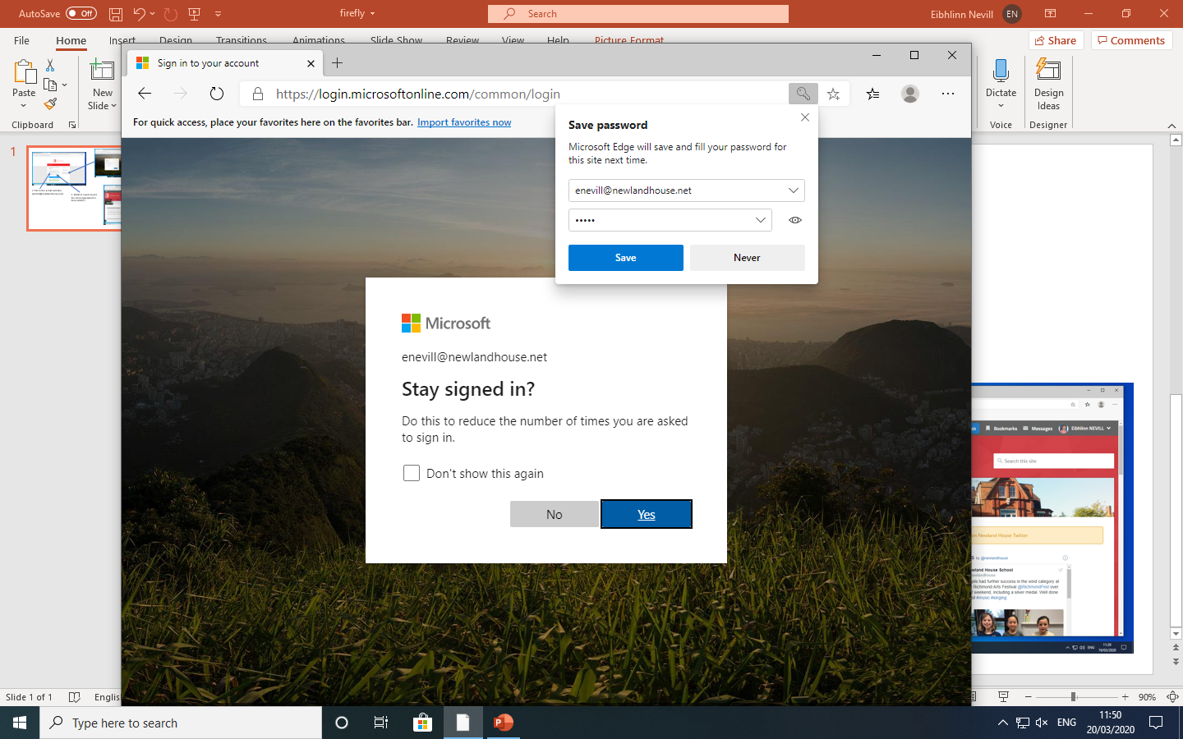
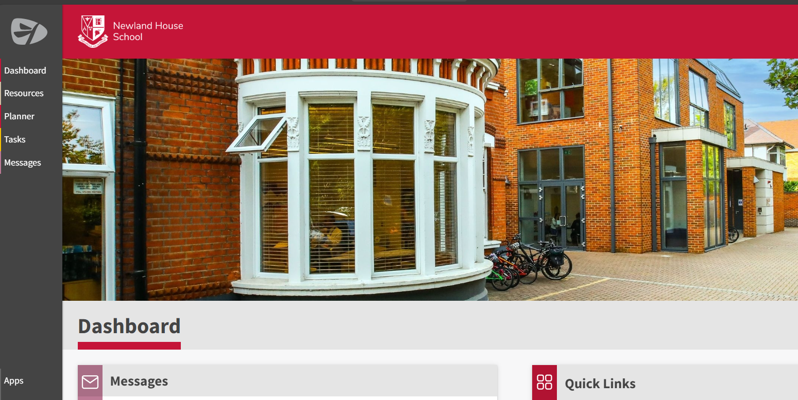
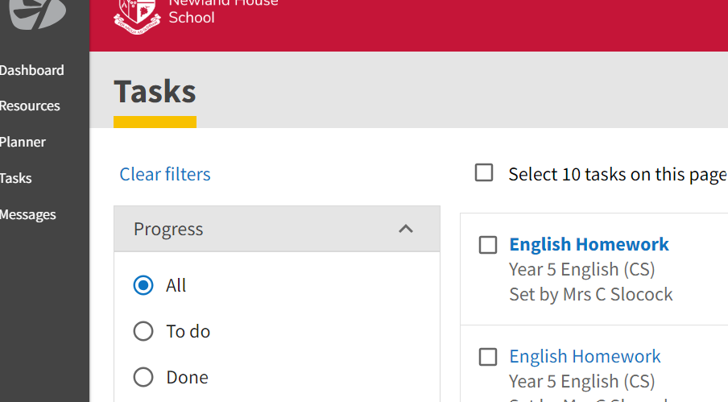
1.Click on: https://newlandhouse.fireflycloud.net/
2. Select Staff & Pupils
Put in the children’s school
e-mail address
(username@newlandhouse.net)
For example, gbruce@newlandhouse.net
5. This is the pupil’s dashboard. Homework can be accessed in tasks (yellow tab). The children/parents will also receive an email in their school outlook inbox notifying them of the set task.
6. Select the task to be completed (e.g. English homework) to find instructions/ support/resources and submission dates etc.
4. Enter pupil’s school password, the one used to log onto the school computers during ICT lessons.

