Slide 1
Children’s guide to BOFA

Slide 2
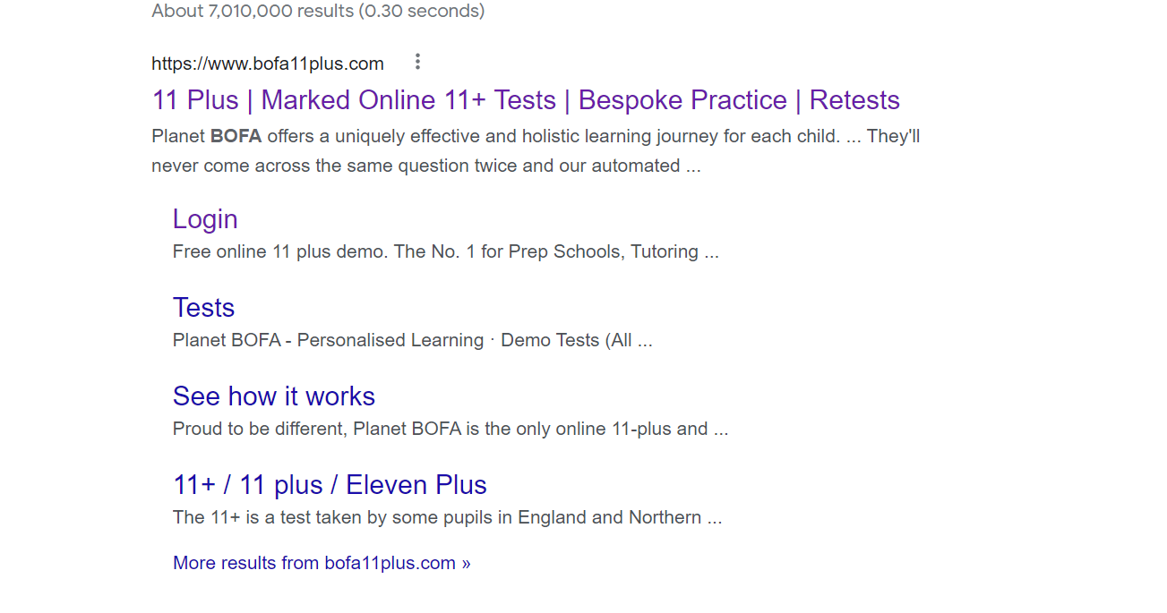
https//www.bofa11+.com
If you search for it, check the web address

Slide 3
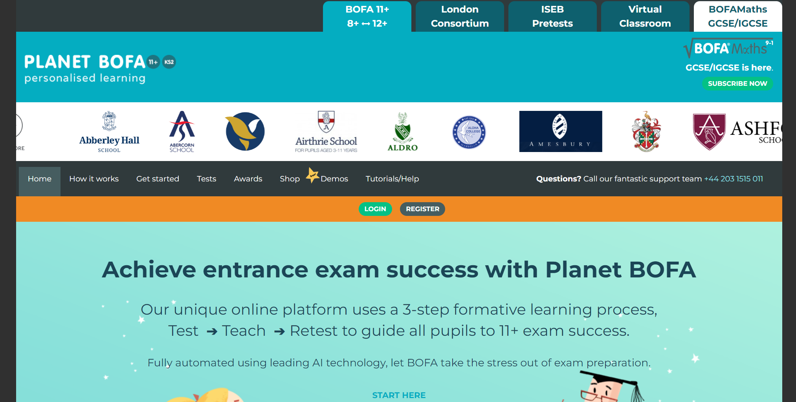
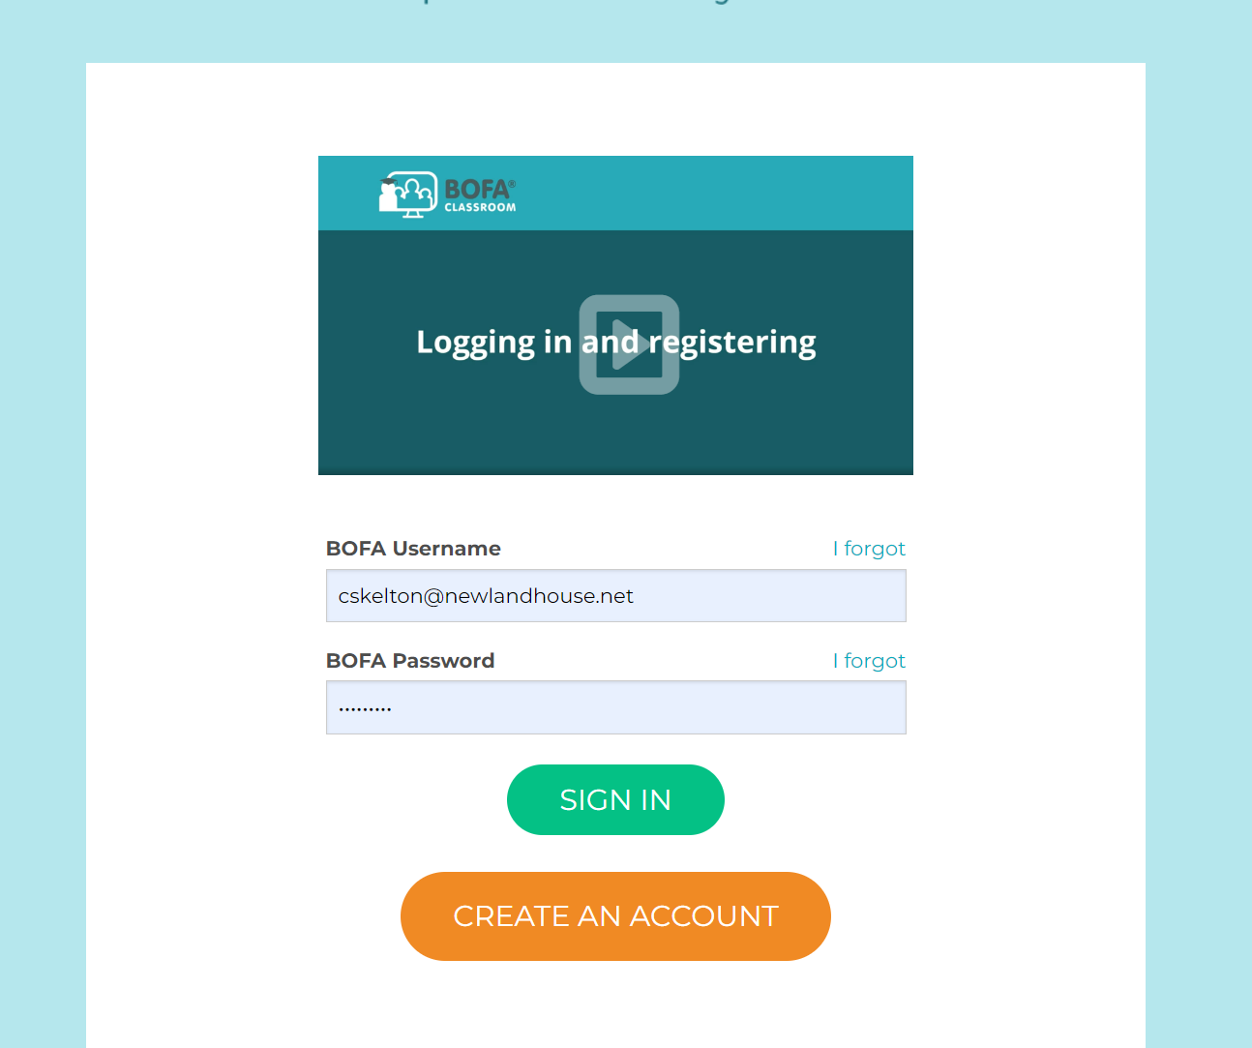
Login

Slide 4
Your login details are your school email address and the password you use to log on at school
For example:
jsmith@newlandhouse.net
js680

Slide 5
What is Bofa?
Here is an explanation.
What do the activities look like?
Let’s look at some of the demos.

Slide 6
There are two sides to Bofa- adaptive and non-adaptive activities.
Adaptive activities will become harder or easier as you go through them. As you use Bofa more, adaptive activities will offer you questions that you have found harder to help you get better on them, rather than you doing things that you already know.
Non-adaptive activities are ones in which the questions are the same for everyone and you work your way through them.

Slide 7
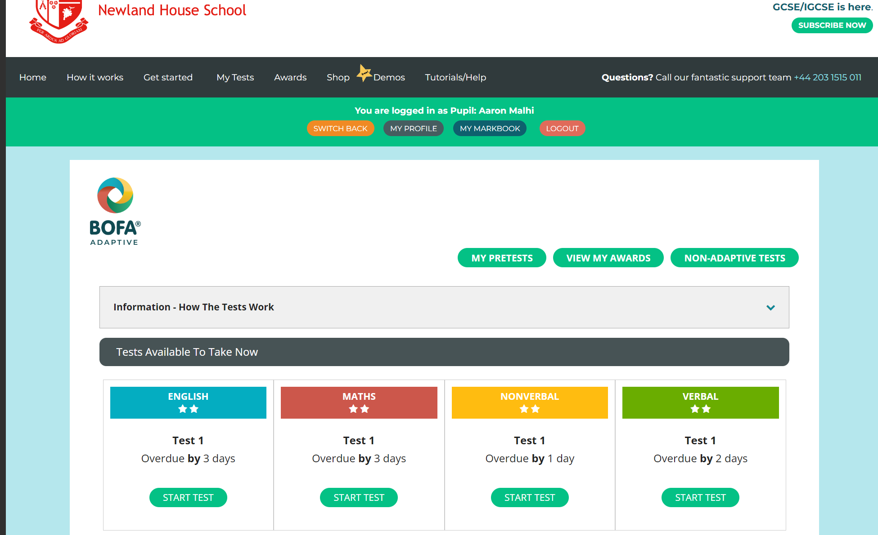
Click here for adaptive tests
Then select the test that you would like to do

Slide 8
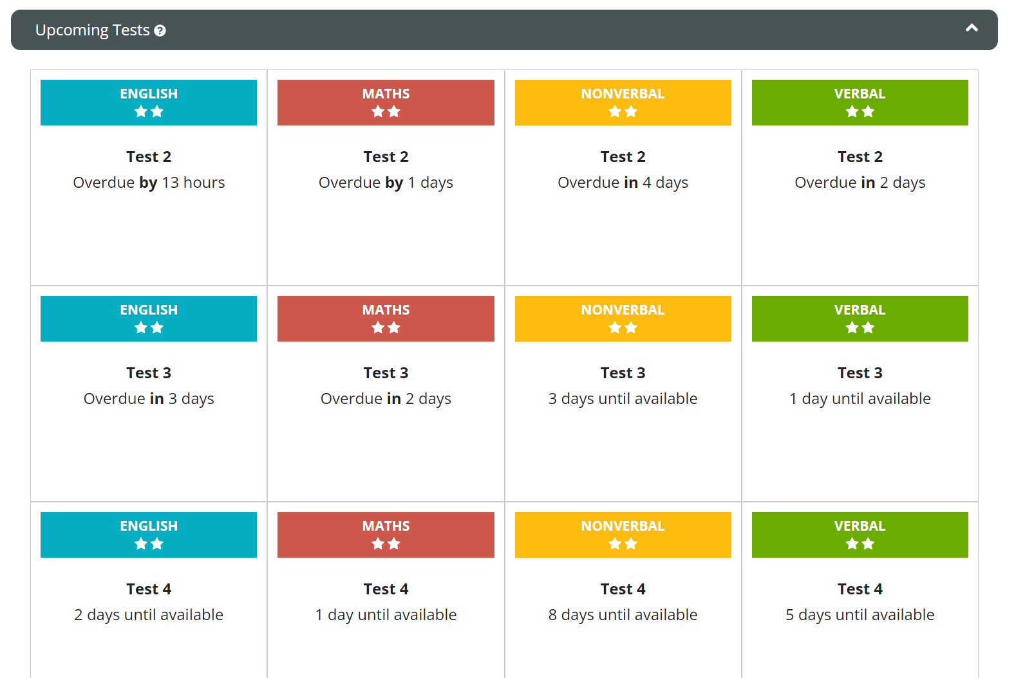
The adaptive tests are staggered so that you have to do them over the period if time.

Slide 9
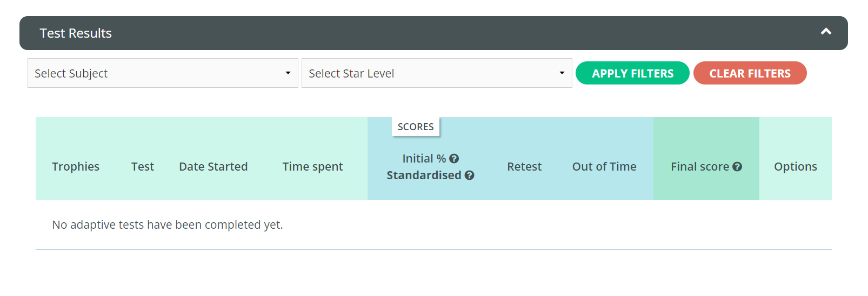
Once you have started doing adaptive tests, at the bottom of the page you can see your results to check your progress.

Slide 10
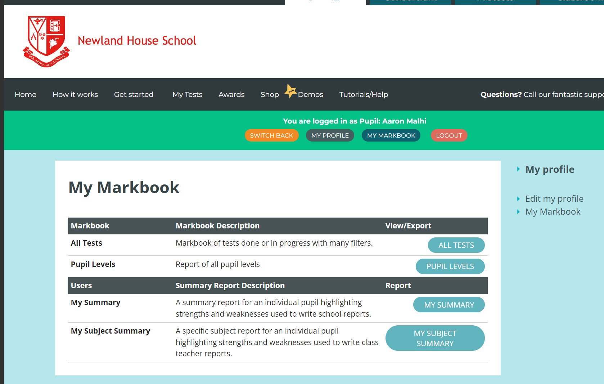
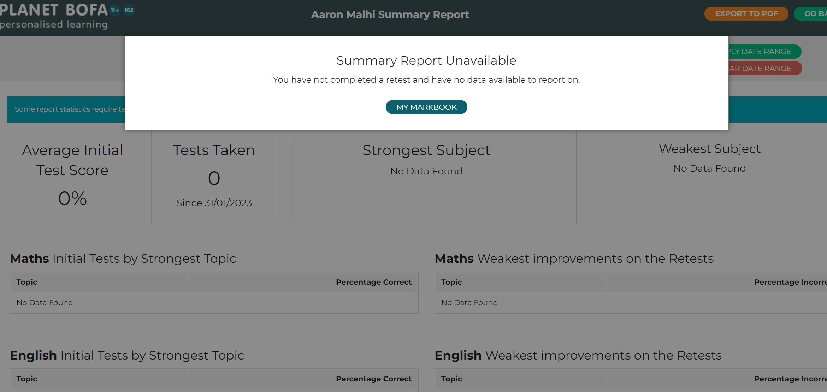
Your markbook gives you more detailed feedback on your strengths and weaknesses.

Slide 11
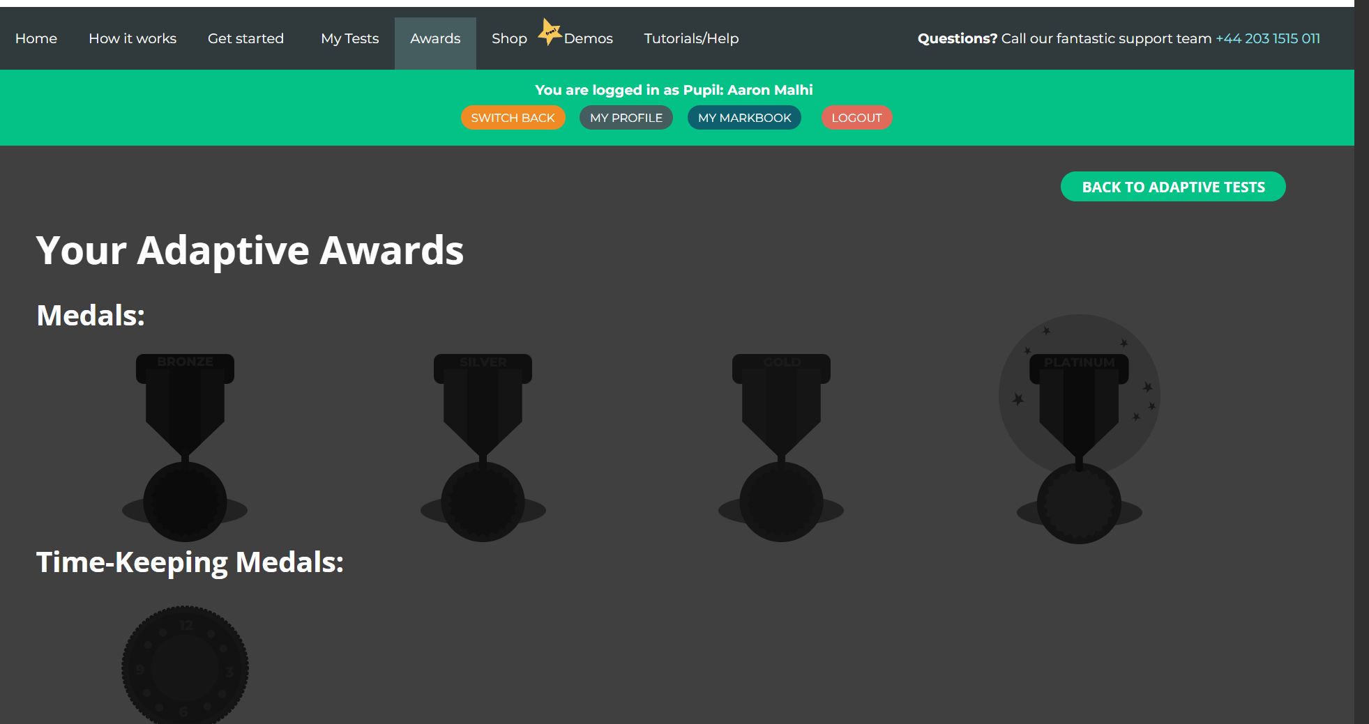
You can also gain awards for excellent effort.

Slide 12
Click here for non- adaptive tests
Then here…

Slide 13
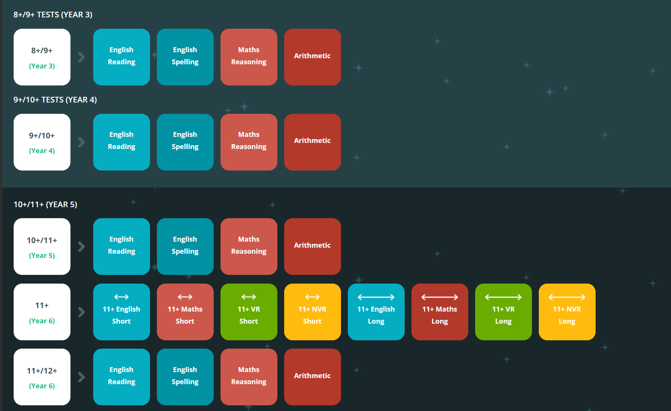
There are loads to choose from.

Slide 14
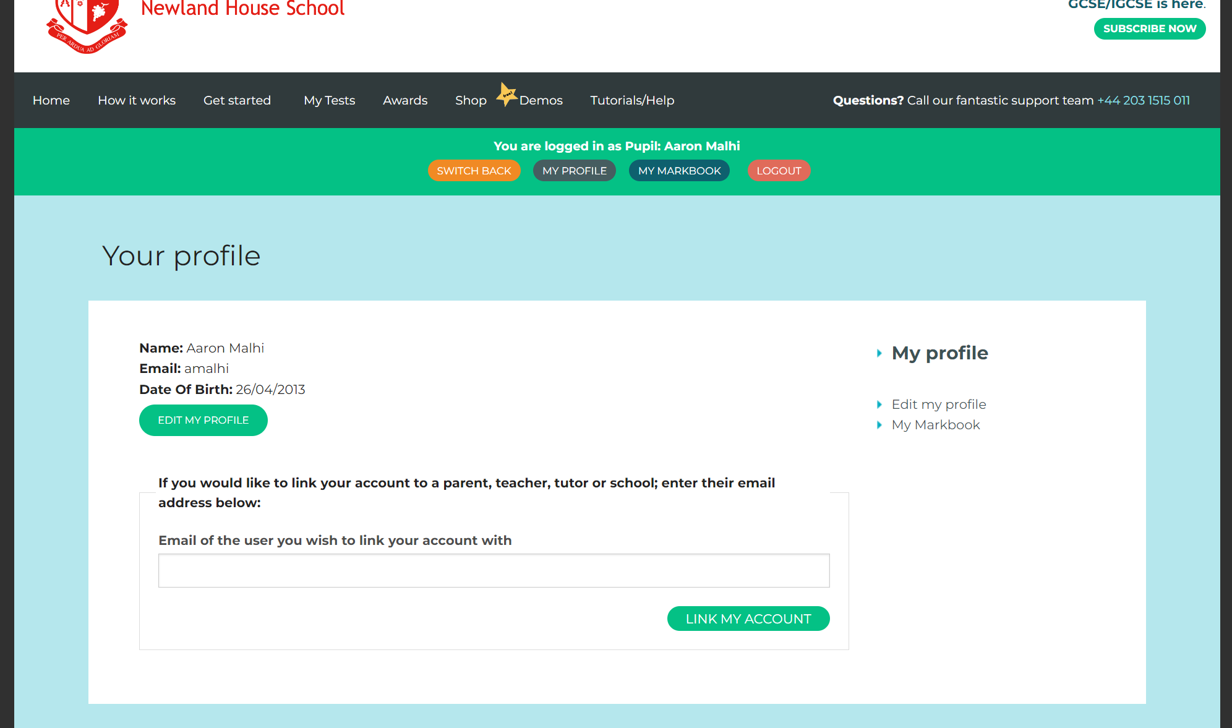
Additional parental information
You can link your child’s details to your account so you get updates on their progress.
After your child has logged
in, ask them to click on ‘My
Profile’

